Slide 1
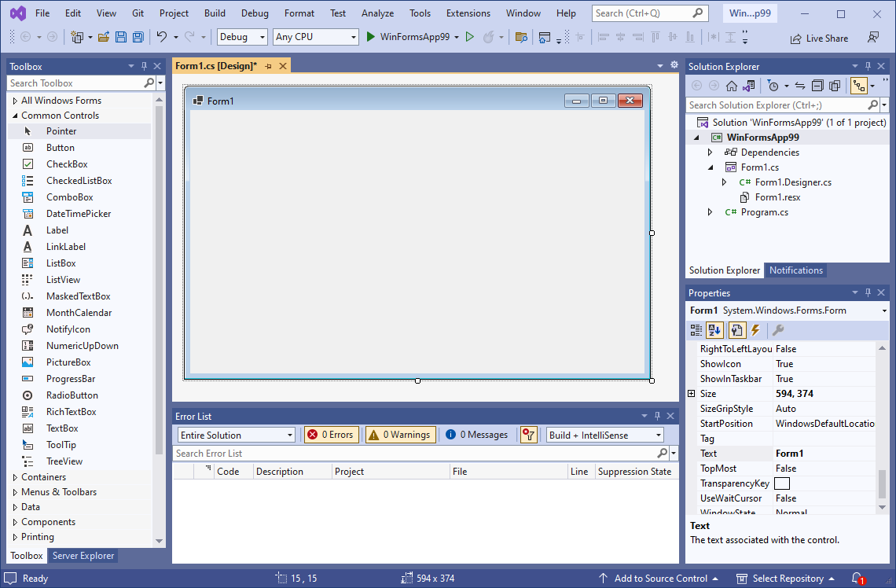
Getting Started with Forms and Controls
When you start a new C# Windows Forms App, an empty form named Form1 is automatically created.
Empty form

Slide 2
The Form’s Bounding Box and Sizing Handles
A form in Designer is enclosed with thin dotted lines called the bounding box
The bounding box has small sizing handles; you can use them to resize the form

Slide 3
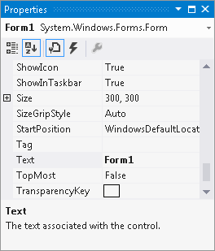
The Properties Window
The appearance and other characteristics of a G U I object are determined by the object's properties
The Properties window lists all properties
When selecting an object, its properties are displayed
in Properties windows
Each property has 2 columns:
Left: property’s name
Right: property’s value

Slide 4
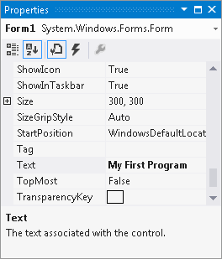
Changing a Property’s Value
Select an object, such as the Form, by clicking it once
Click View and select Properties if the Properties window is not available
Find the property’s name in the list and change its value
The Text property determines the text to be displayed
in the form’s title bar
Example: Change the
value from “Form1”
to
“My First Program”

Slide 5
Adding Controls to a Form
In the Toolbox, select the Control (e.g. a Button), then you can either:
double click the Button control
click and drag the Button control to the form
On the form, you can
resize the control using its bounding box and sizing handles
move the control’s position by dragging it
change its properties in the Properties window

Slide 6
Rules for Naming Controls
Controls’ are identified by their names in code
The naming rules are:
The first character must be a letter (lower or uppercase, does not matter) or an underscore (_)
All other characters can be alphanumerical characters or underscores
The name cannot contain spaces
Examples of valid names are:
showDayButton
DisplayTotal
_ScoreLabel

Slide 7
Creating the G U I for Your First Visual C# Application
In section 2.2 you will start creating an app that has a Form and a Button control
When the app is finished, it will display the message "Hello World" when the Button control is clicked
In this section you will create the GUI
In section 2.3 you will learn the details of coding an app
In section 2.4 you will write the code that displays “Hello World” when the user clicks the button

Slide 8
Introduction to C# Code
code is primarily organized in three ways:
Namespace: a container that holds classes
Class: a container that holds methods
Method: a group of one or more programming statements that perform some operations
A file that contains program code is called a source code file

Slide 9
Source Code in the Solution Explorer
Each time a new project is created the following two source code files are automatically created:
Program.c s file: contains the application’s start-up code to be executed when the application runs
Form1.c s contains code that is associated with the Form1 form

Slide 10
Source Code in the Solution Explorer
You can open them through the Solution Explorer

Slide 11
Organization of the Form1.cs
A sample of Form1.c s:
The user-defined namespace of the project
Class declaration
A method

Slide 12
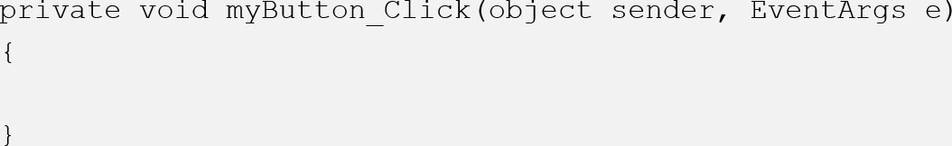
Adding Your Code
G U I applications are event-driven which means they respond to events that occur while the application is running
An event is a user’s action such as mouse clicking, key pressing, etc.
In the Designer, double clicking a control such as Button will link the control to a default Event Handler
An event handler is a method that executes when a specific event takes place
A code segment similar to the following will be created automatically:

Slide 13
Message Boxes
A message box (aka dialog box) displays a message
.NET provides a method named MessageBox.Show
The method displays a window with a message. A sample code is (bold line):
private void myButton_Click(object sender, EventArgs e)
{
MessageBox.Show("Thanks for clicking the button!");
}
Placing it in the myButton_Click event handler can display the string in the message box when the button is clicked

Slide 14
Writing Code for the Hello World Application
The completed source code of Form1.c s is:

Slide 15
Label Controls
A Label control displays text on a form and can be used to display unchanging text or program output
Commonly used properties are:
Text: gets or sets the text associated with Label control
Name: gets or sets the name of Label control
Font: allows you to set the font, font style, and font size
BorderStyle: allows you to display a border around the control’s text
AutoSize: controls the way they can be resized
TextAlign: set the text alignments

Slide 16
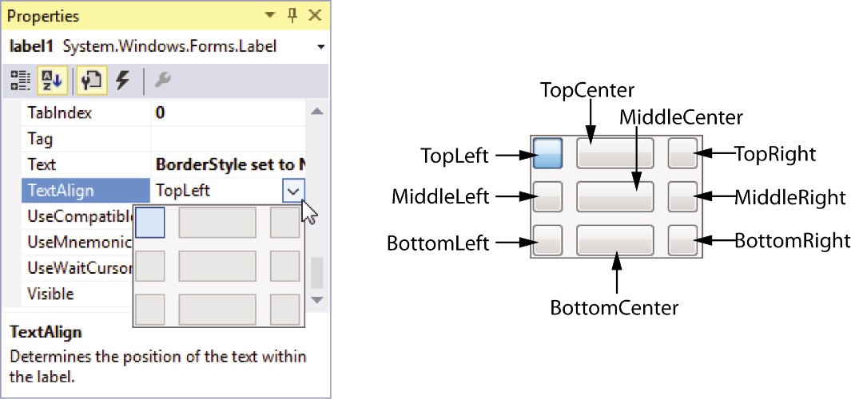
Handling Text Alignments
The TextAlign property supports the following values:
TopLeft | TopCenter | TopRight
MiddleLeft | MiddleCenter | MiddleRight
BottomLeft | BottomCenter | BottomRight
You can select them by clicking the down-arrow button of the TextAlign property

Slide 17
Using Code to Display Output in a Label Control
By adding the following bold line to a Button's event handler, a Label control can display output of the application.
private void showAnswerButton_Click(object sender, EventArgs e)
{
answerLabel.Text = "Theodore Roosevelt";
}
Notice that
the equal sign (=) is known as assignment operator
the item receiving the value must be on the left of the = operator
the Text property accepts a string only
if you need to clear the text of a Label, simply assign an empty string ("") to clear the Text property

Slide 18
2.6 Making Sense of IntelliSense
IntelliSense provides automatic code completion as you write programming statements
It provides an array of options that make language references easily accessible
With it, you can find the information you need, and insert language elements directly into your code

Slide 19
PictureBox Controls
A PictureBox control displays a graphic image on a form
Commonly used properties are:
Image: specifies the image that it will display
SizeMode: specifies how the control’s image is to be displayed
Visible: determines whether the control is visible on the form at run time

Slide 20
Creating Clickable Images
You can double click the PictureBox control in the Designer to create a Click event handler and then add your codes to it. For example,
private void catPictureBox_Click(object sender, EventArgs e)
{
MessageBox.Show("Meow");
}
And
private void spiderPictureBox_Click(object sender, EventArgs e)
{
spiderPictureBox.Visible = false;
}

Slide 21
Sequential Execution of Statements
Programmers need to carefully arrange the sequence of statements in order to generate the correct results
In the following example, the statements in the method execute in the order that they appear:
private void showBackButton_Click(object sender, EventArgs e)
{
cardBackPictureBox.Visible = true;
cardFacePictureBox.Visible = false;
}
Incorrect arrangement of sequence can cause logic errors

Slide 22
Comments, Blank Links, and Indentation
Comments are brief notes that are placed in a program’s source code to explain how parts of the program work
A line comment appears on one line in a program
// Make image of the card back visible.
cardBackPictureBox.Visible = true;
A block comment can occupy multiple consecutive lines in a program
/*
Line one
Line two
*/

Slide 23
Writing the Code to Close an Application’s Form
To close an application’s form in code, use the following statement:
this.Close();
A commonly used practice is to create an Exit button and manually add the code to it:
private void exitButton_Click(object sender, EventArgs e)
{
// Close the form.
this.Close();
}

Slide 24
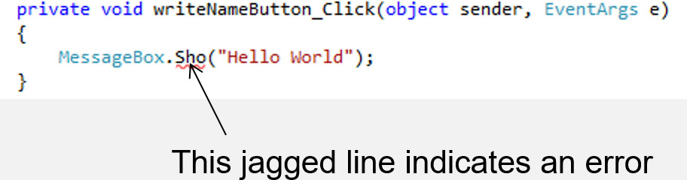
Dealing with Syntax Errors
The Visual Studio code editor examines each statement as you type it and reports any syntax errors that are found
If a syntax error is found, it is underlined with a jagged line
If a syntax error exists and you attempt to compile and execute, you will see the following window

